Slide 1
Advanced methods of
molecular dynamics
Monte Carlo methods
Free energy calculations
Ab initio molecular dynamics
Quantum molecular dynamics
Trajectory analysis

Slide 2
When classical mechanics is not adequate?
A “quantum measure“ of an object with mass m
And kinetic energy E is its de Broglie wave length:
λ = 2πћ/p = 2πћ/(2mE)^{1/2}
Shall d be the characteristic dimension of the system, then:
λ << d classical mechanics,
λ ≥ d quantum mechanics.

Slide 3
λ of selected objects
1. A student running “classic”
late for class:
m = 70 kg, v = 5 m/s λ ~ 10⁻³⁶ m
e⁻
2. Valence electron: quantum
m = 9x10 ⁻³¹kg, E = 1 eV λ ~ 10⁻⁹ m
Ne
3. Vibrating neon atom: semi-quantum
m = 2x10 ⁻²⁶kg, E = 0.01 eV λ ~ 10⁻¹⁰ m

Slide 4
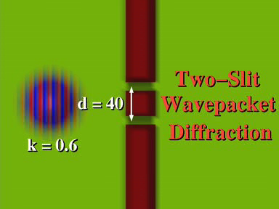
Particle – wave dualism
Wave character of quantum objects:
double slit experiment - difraction
R. Kosloff et al., HU Jerusalem

Slide 5

Even classical objects can
exhibit wave behavior ☺
R. Kosloff et al., HU Jerusalem

Slide 6
Quantum motions of atoms and molecules
1. Zero point vibrations –
energy cannot decrease below hω/2
2. Tunneling – under a barrier between two wells
(also above the barrier reflection)
3. Energy transfer via quantum resonances,
interferences

Slide 7
Quantum interactions
1. With electrons: Non-adiabatic interactions – avoided crossings, conical intersections,…
2. With photons: electronic/vibrational/rotational
photoexcitations - spectroscopy, control of
reactions by optical pulses, …

Slide 8
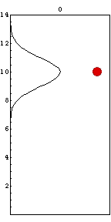
Quantum vs classical mechanics
Comparison between a quantum and classical ball
elastic vibrations (elasticaly bouncing from the floor)
M. Reed, Yale University

Slide 9
Time-dependent vs time-independent
Classical mechanics: time-dependent (dynamical
Newton equations)
Quantum mechanics:
time-independent: HΨ=E Ψ time-dependent: ih∂Ψ/∂t =HΨ
Stationary bound and
Scattering states Ψ _{j}, E _{j};
time-indep. Hamiltonian
Dynamical evolution, non-
Stationary response Ψ(t); also
for a time-dep. Hamiltonian
For time-indep. Hamiltonian (in principle) equivalent:
Ψ(t) = ∑ _{j} Ψ_{j} exp[(-i/h)E_{j}t]

